Slide 1
Parallel Matrix Multiplication for Large-Scale Data Analysis: A Comparative Study of Serial and Parallel Processing Methods
HIGH PERFORMANCE SCIENTIFIC COMPUTING
SRAVANI KAIRAM KONDA ID:02130417

Slide 2

Abstract
Matrix multiplication is a computationally intensive task critical in many scientific and engineering applications.
This presentation evaluates the performance of serial and parallel implementations of matrix multiplication.
Metrics such as execution time, speedup, and efficiency are analyzed for varying matrix sizes and processor counts.

Slide 3
Introduction
Problem Statement: Matrix multiplication requires significant computational resources, making it a prime candidate for parallelization.
Objective: To compare the performance of serial and parallel matrix multiplication using metrics like execution time, speedup, and efficiency.
Why Parallelize Matrix Multiplication?
Challenges with Large Matrices: As the size of matrices grows, matrix multiplication becomes increasingly time-consuming with traditional serial algorithms.
Parallelization allows distributing the computation across multiple processors, reducing execution time significantly, especially for large-scale data analysis.
Applications: Faster matrix multiplication can speed up machine learning algorithms, simulations, and large data analyses in fields such as computer vision, data mining, and scientific research.

Slide 4
Methodology
Serial Implementation:
Iterative approach with nested loops.
Computes each matrix element sequentially.
Parallel Implementation:
Utilizes Python’s multiprocessing library.
Distributes rows of the first matrix across processors.
Benchmarking:
Tested with varying matrix sizes (e.g., 100x100 and 1000x1000).
Processor counts: 1, 2, 4, 8, 16.

Slide 5
Parallelization Method
Parallel Matrix Multiplication:
The task is split into smaller chunks (rows of the result matrix) and computed simultaneously using multiple processors.
This greatly reduces execution time for large matrices.
Speedup and Efficiency:
Speedup: The ratio of serial time to parallel time.
Efficiency: Speedup divided by the number of processors used, showing how effectively processors are utilized.

Slide 6
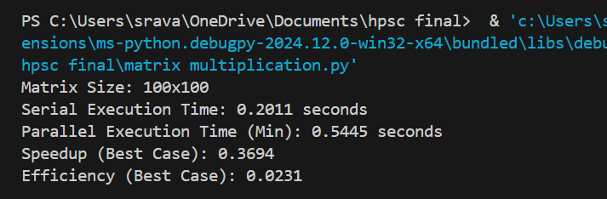
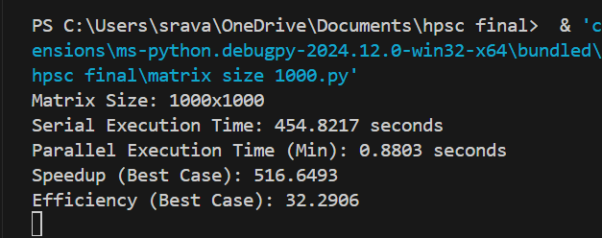
Numerical Results
For 100*100 size:
For 1000*1000 size:

Slide 7
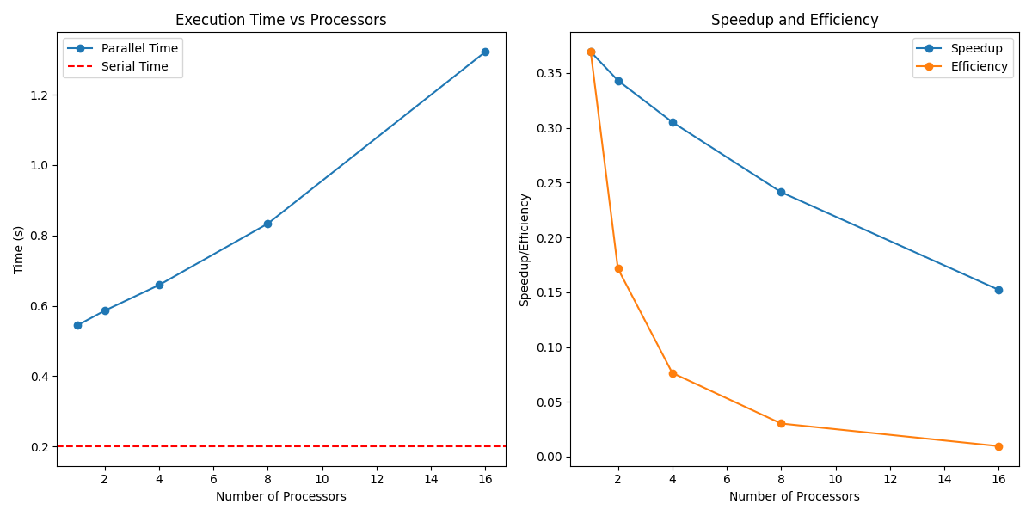
Visualization
For 100*100:
For 1000*1000:

Slide 8
Conclusion
Findings:
Parallel matrix multiplication drastically reduces execution time compared to serial processing.
The use of multiple processors enhances performance, but the efficiency declines after a certain point due to system limitations.
Implications:
Parallel matrix multiplication offers significant improvements in computational tasks, especially for large datasets, and demonstrates the power of parallel computing in solving real-world problems efficiently.

Slide 9
References
Gropp, W., Lusk, E., & Skjellum, A. (1999). Using MPI: Portable Parallel Programming with the Message-Passing Interface. MIT Press.
Python multiprocessing documentation: https://docs.python.org/3/library/multiprocessing.html
High-performance matrix multiplication optimization: https://en.wikipedia.org/wiki/Matrix_multiplication

Slide 10
THANK YOU!

